Slide 1




GROUP 8
Varun Khanna 101415041
Aman Gupta 101420524
Alex Vecchiettini 101439446
Mehul Sharma 101414996
Manasi Rane 101414495
Belle Pensamiento 101398784
Kirti Takrani 101423492
1
Notes:
Landscape based Image classification

Slide 2


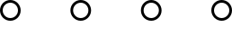
INDEX
Part 1
Problem Statement
Frequency domain and Fourier transform
LPF and HPF
Conclusion and further development
Part 2
Problem statement
Dataset
Data pre-processing
Models
Logistic regression
Random forest
Further development and conclusion
2

Slide 3
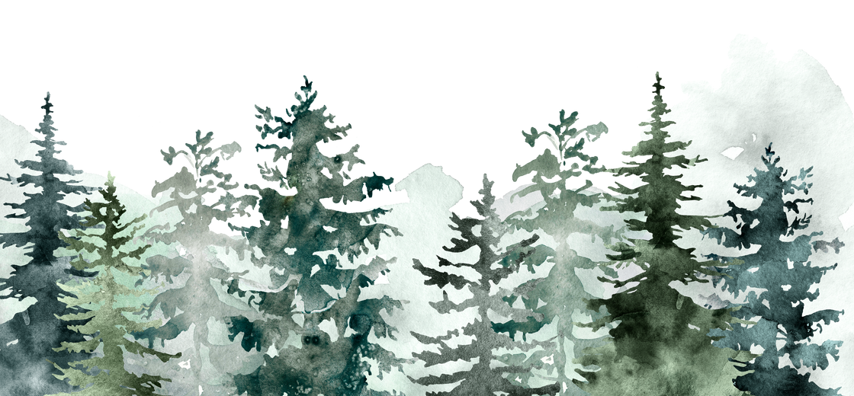
PART 1
Image Enhancer using Fourier Transform
3
Notes:
Landscape based Image classification

Slide 4

PROBLEM STATEMENT
Create software for image enhancement using Fourier transformation to obtain the image's frequency domain, in particular, implement the following:
Blurring
sharpening
edge detection
noise suppression
4

Slide 5
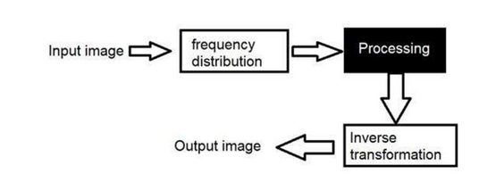

FREQUENCY DOMAIN
Rate at which the pixel values are changing in spatial domain
FFT
Each point represents a particular frequency contained in the spatial domain image.
MAGNITUDE tells "how much" of a certain frequency component is present
PHASE tells "where" the frequency component is in the image.
5

Slide 6
LPF AND HPF
LPF and HPF can be applied to the frequency domain to obtain blurring, sharpening, edge detection, and noise filtering. Different parameters will yield different results, in general, we can see that:
Blurring is obtained with a LPF that dampens the high frequencies
Sharpening can be obtained by applying an HPF to reduce the values of the low frequencies
Edge detection is achieved by increasing the effect of the HPF and bringing the low frequencies to values close to 0
Noise filtering, similar to blurring, is achieved through an LPF with a stronger effect on the high frequencies.
HOWEVER...
6

Slide 7
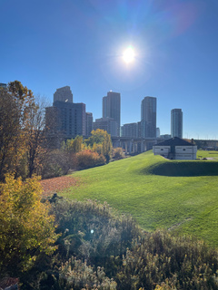
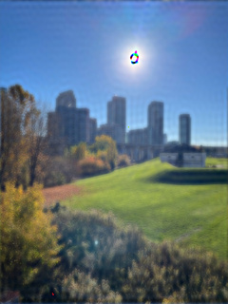
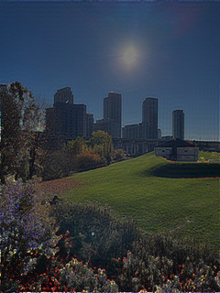
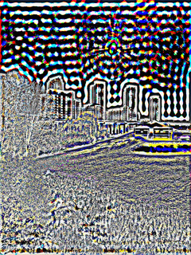




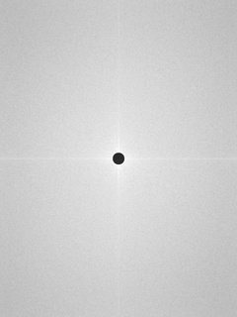

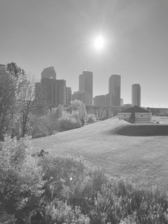

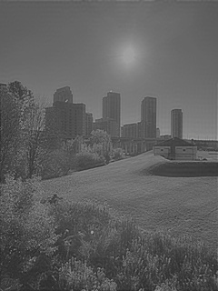
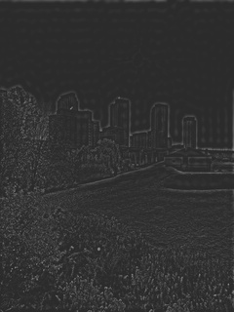
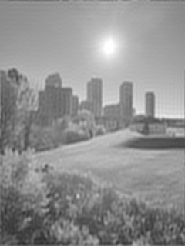
RESULTS
7

Slide 8
RESULTS EVALUATION
As we saw LPF and HPF are not ideal, in particular for color images where a color distortion becomes evident.
Furthermore, we can see how dampening values can result in a darker image.
While the latter can be resolved with image post-processing in the space domain to increase the overall brightness of the image and the first one can be resolved partially by fine-tuning the filter to the image, to obtain marginally better results there are better algorithms in the space domain to achieve the required image enhancements, such as:
Sobel filter for edge detection
Gaussian, Mean, Median, and Bilateral filters can be used to deal with different kind of noise.
Further improvements will be directed towards the development of a GUI to show in real time the result of different parameters in the LPF and HPF.
8

Slide 9
PART 2
landscape based image classification
9
Notes:
Landscape based Image classification

Slide 10


DATASET
https://www.kaggle.com/datasets/puneet6060/intel-image-classification
Our image dataset includes digital images curated for testing, training, and evaluating the performance of machine learning and artificial intelligence (AI) algorithms, commonly computer vision algorithms.
This Data contains around 25 k images of size 150x150 distributed under 6 categories.
{'BUILDINGS' -> 0,'FOREST' -> 1,'GLACIER' -> 2,'MOUNTAIN' -> 3,'SEA' -> 4,'STREET' -> 5 }
10

Slide 11
DATA PIPELINE
DATA SOURCE:
KAGGLE
GOOGLE DRIVE
GOOGLE COLAB
PYTHON IMAGING LIBRARY (PIL)
OPENCV (CV2)
ALGORITHIMS:
LOGISTIC REGRESSION
RANDOM FOREST
SVM
KNN
DECISION TREE
RESHAPING, RESIZING
TRAIN TEST SPLIT
11

Slide 12
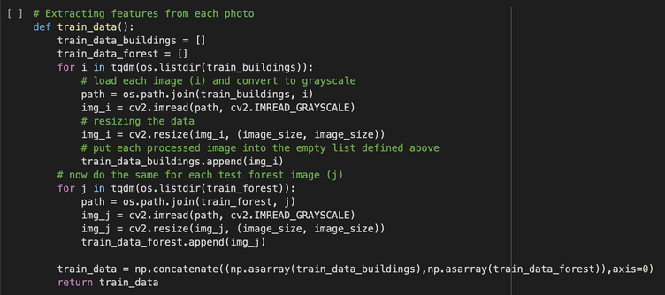
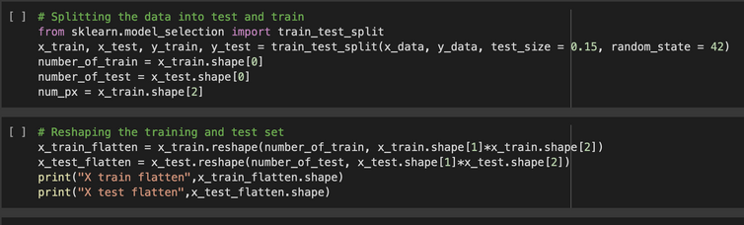
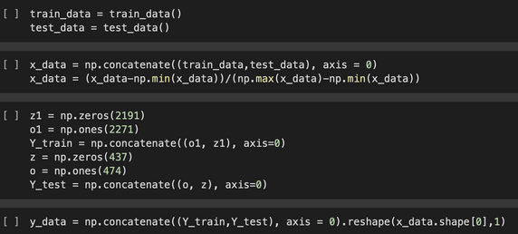
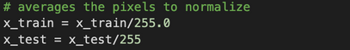
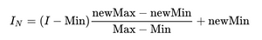
DATA PREPROCCESSING
Loading the Data into Grayscale
Train Test Split
IMPORTANT!
Avoid using too much technical detail or using excessive jargon when presenting them.
creating target classes (1 = building, 0= forest)
Normalizes the pixel values, room for improvement
12

Slide 13

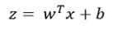
LOGISTIC REGRESSION
Logistic Regression is one of the supervised machine learning algorithms that can work on both binary and multiclass classification very well.
It operates basically through a sigmoidal function for values ranging between 0 and 1.
In the context of image processing, this could mean identifying whether a given image belongs to a particular class (y=1) or not (y=0), e.g. "cat" or "not cat".
Formulas used in logistic regression:
Here z is the output variable, and x is the input variable. w and b will be initialized as zeros to start with and they will be modified by the number of iterations while training the model.
13

Slide 14
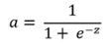
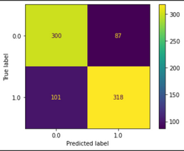
LOGISTIC REGRESSION
This output z is passed through a sigmoid (non-linear) function that returns a value between 0 and 1.
This ‘a’ will be the final output that is the value in the ‘y_train’ or ‘y_test’.
Hyperparameters which gave the maximum accuracy: LogisticRegression(C=10,penalty="l2",random_state = 42)
The accuracy we got from LR Model on the test dataset is 75%
Confusion Matrix: To see if its better at classifying forests or buildings
Buildings slightly more precise
14

Slide 15
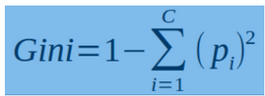
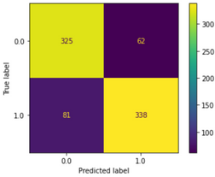
RANDOM FOREST
A Random Forest is a classifier consisting of a collection of tree structured classifiers (…) independent identically distributed random vectors and each tree casts a unit vote for the most popular class at input x .
This formula uses the class and probability to determine the Gini of each branch on a node, determining which of the branches is more likely to occur.
Here, pi represents the relative frequency of the class you are observing in the dataset and c represents the number of classes.
As expected random forest gives better performance than logistic regression with an accuracy of 82% on the test dataset.
More precise for Buildings
15

Slide 16
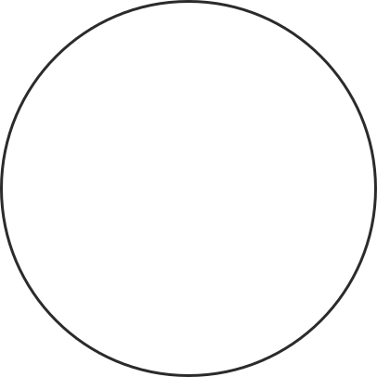
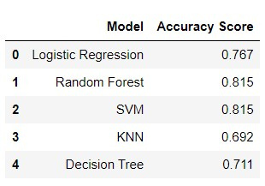






























Conclusion
16

Slide 17

Further Enhancements
Randomized SearchCV
GridsSearchCV
Ensemble Methods
Feature Selection
Confusion Matrices for other Algorithsm
17

Slide 18

THANK YOU !!!
Github repo: https://github.com/alexvecchiettini/image-processing.git
18

Slide 19





Question???
19

